Slide 1
Capstone Project
NYC Taxi Trip Time Prediction
BY
Rishabh Patidar
Vikash Shrivas

Slide 2

Content
Problem Statement / Description
Introduction
Data preparation & cleaning
EDA and Data Processing
Decomposition of Data:PCA
ML Model – Regression
Linear Regression
Decision Tree
Random Forest
Conclusion

Slide 3
Problem Description
Our task is to build a model that predicts the total ride duration of taxi trip in New York City. For this, we are using the dataset released by the NYC Taxi and Limousine Commission which includes pickup time, geo-coordinates, Number of passengers and service types.
Data Description
The dataset is based on the 2016 NYC Yellow Cab trip record The data was sampled and cleaned for the purposes of this project. Based on individual trip attributes, you should predict the duration of each trip in the test set.
NYC Taxi Data.csv - the training set (contains 1458644 trip records)
Data fields
id - a unique identifier for each trip
vendor_id - a code indicating the provider associated with the trip record
pickup_datetime - date and time when the meter was engaged
dropoff_datetime - date and time when the meter was disengaged
passenger_count - the number of passengers in the vehicle (driver entered value)
pickup_longitude - the longitude where the meter was engaged
pickup_latitude - the latitude where the meter was engaged
dropoff_longitude - the longitude where the meter was disengaged
dropoff_latitude - the latitude where the meter was disengaged
store_and_fwd_flag - This flag indicates whether the trip record was held in vehicle memory before sending to the vendor because the vehicle did not have a connection to the server - Y=store and forward; N=not a store and forward trip
trip_duration - duration of the trip in seconds

Slide 4

Introduction
The data represents information about trips in New York taxis. The prediction methodology is a regression model (predicting trip duration) based on given variables. When you are searching for a van on our site, various variables will be highlighted such as the pickup location's longitude and latitude options. The preprocessing of the feature explanation allows you to get the information that you need quickly, while selecting data helps reduce noise or irrelevant information.
To make our prediction more powerful, we've been doing some testing to figure out how to model these features

Slide 5
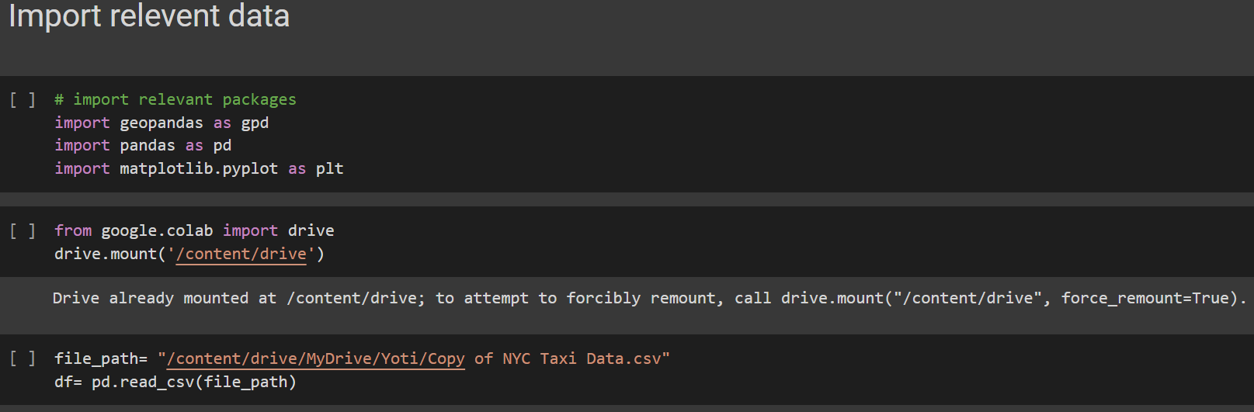
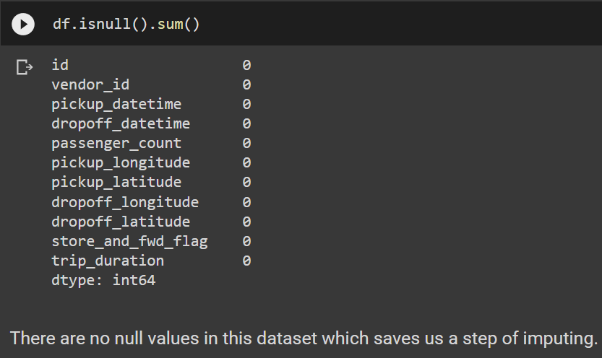
Data preparation & cleaning
To know if there is any missing value or Nan value in the dataset, we can use the isnull() function.

Slide 6
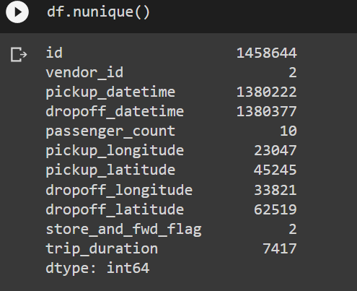
check unique values of all columns.
check a statistical summary of our dataset
df.describe()
That method returns description of the data in the DataFrame.
Some insights from the above summary:
Vendor id has a minimum value of 1 and a maximum value of 2 which makes sense as we saw there are two vendor ids 1 and 2.
Passenger count has a minimum of 0 which means either it is an error entered or the drivers deliberately entered 0 to complete a target number of rides.
The minimum trip duration is also quite low. We will come back to this later during Univariate Analysis.
We see that id has 1458644 unique values which are equal to the number of rows in our dataset. There are 2 unique vendor ids. There are 10 unique passenger counts. There are 2 unique values for store_and_fwd_flag, that we also saw in the description of the variables, which are Y and N.

Slide 7
We have created the following features:
pickup_day and dropoff_day which will contain the name of the day on which the ride was taken.
pickup_day_no and dropoff_day_no which will contain the day number instead of characters with Monday=0 and Sunday=6.
pickup_hour and dropoff_hour with an hour of the day in the 24-hour format.
pickup_month and dropoff_month with month number with January=1 and December=12.
Next, I defined a function that lets us determine what time of the day the ride was taken. I created 4 time zones ‘Morning’ (from 6:00 am to 11:59 pm), ‘Afternoon’ (from 12 noon to 3:59 pm), ‘Evening’ (from 4:00 pm to 9:59 pm), and ‘Late Night’ (from 10:00 pm to 5:59 am)
Also saw during dataset exploration that coordinates in the form of longitude and latitude for pickup and dropoff. But, i can’t really gather any insights or draw conclusions from that. So, the most obvious feature that i can extract from this is distance. Let us do that.
Importing the library which lets us calculate distance from geographical coordinates.
from geopy.distance import great_circle

Slide 8
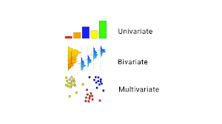

EDA and Data Processing
Univariate
Bivariate

Slide 9
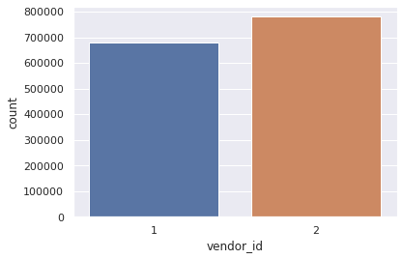
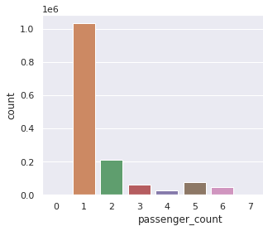
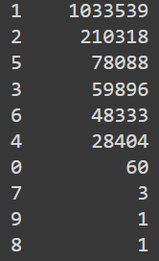
Univariate Analysis
The univariate analysis involves studying patterns of all variables individually.
Vendor id
Passenger Count
see that there is not much difference between the trips taken by both vendors.
There are some trips with even 0 passenger count. There is only 1 trip each for 8 and 9 passengers.
the highest amount of trips are with 1 passenger.

Slide 10
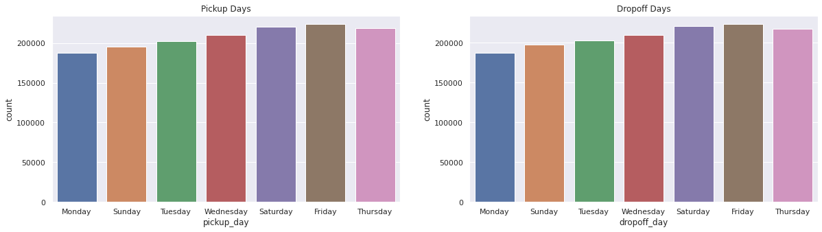
Trips per Day
Fridays are the busiest days followed by Saturdays. That is probably because it’s weekend.

Slide 11
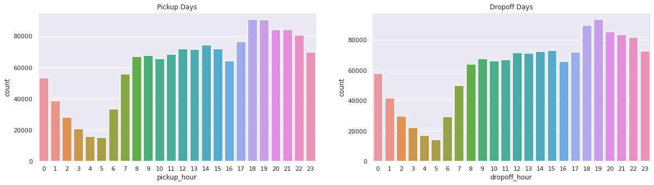
Trips per Hour
the busiest hours are 6:00 pm to 7:00 pm and that makes sense as this is the time when people return from their offices.

Slide 12
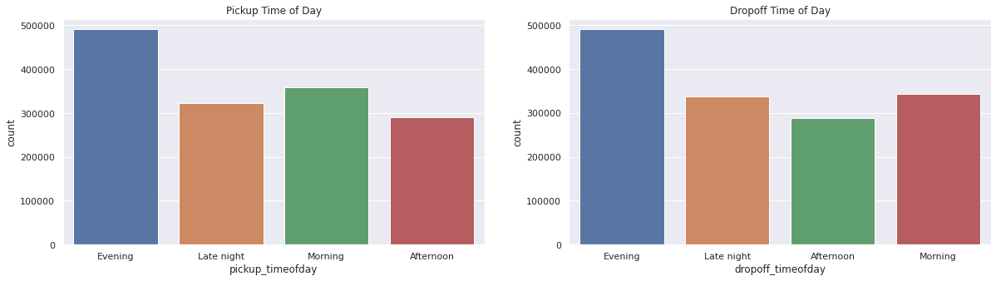
Trips per Time of Day
As we saw above, evenings are the busiest

Slide 13
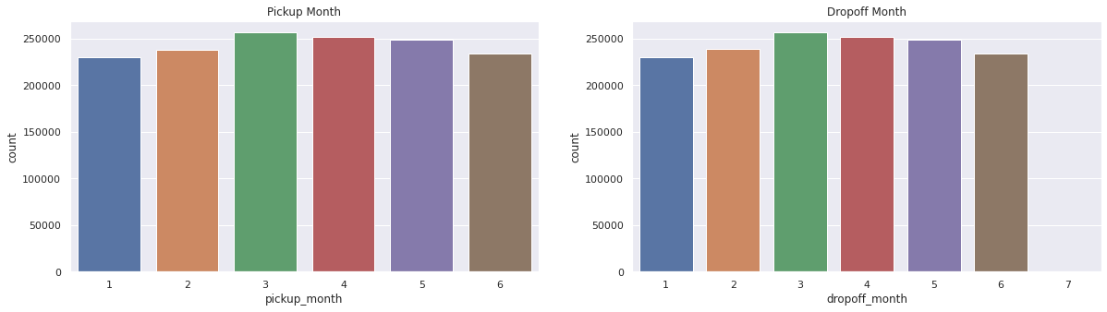
Trips per month
There is not much difference in the number of trips across months.
Now, we will analyze all these variables further in bivariate analysis.

Slide 14
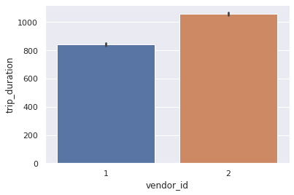
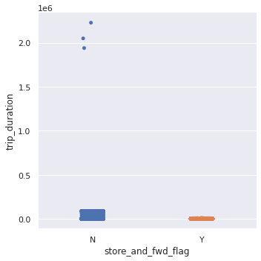
Bivariate Analysis
Bivariate Analysis involves finding relationships, patterns, and correlations between two variables.
Trip Duration per Vendor
Trip Duration per Store and Forward Flag
Trip duration is generally longer for trips whose flag was not stored.
Vendor id 2 takes longer trips as compared to vendor 1

Slide 15
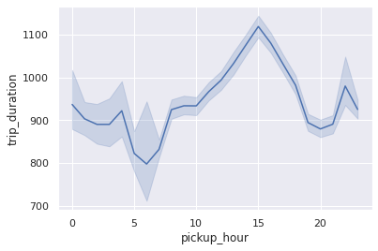
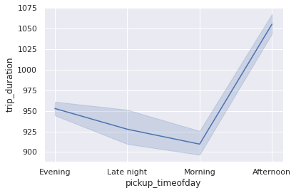
Trip Duration per hour
Trip Duration per time of day
the trip duration is the maximum around 3 pm which may be because of traffic on the roads. Trip duration is the lowest around 6 am as streets may not be busy.
Trip duration is the maximum in the afternoon and lowest between late night and morning.

Slide 16
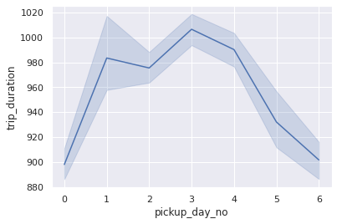
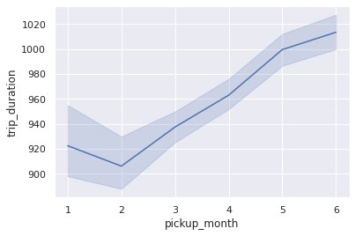
Trip Duration per Day of Week
Trip Duration per month
Trip duration is the longest on Mondays closely followed by Fridays.
From February, we can see trip duration rising every month.

Slide 17
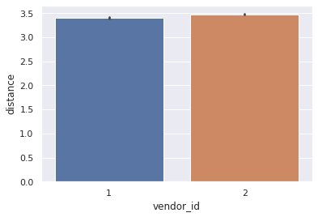
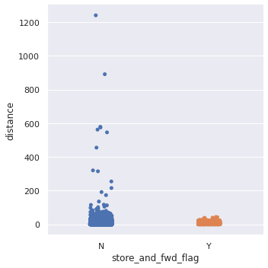
Distance and Vendor
Distance and Store and Forward Flag
The distribution for both vendors is very similar
for longer distances the trip is not stored

Slide 18
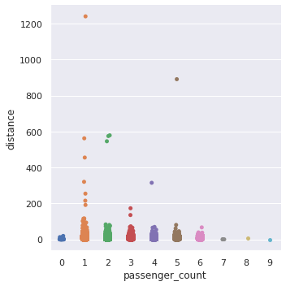
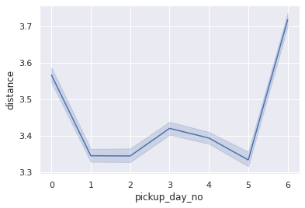
Distance per passenger count
Distance per day of week
Distance are longer on Sundays probably because it’s the weekend.
Monday trip distances are also quite high.
This probably means that there can be outstation trips on these days and/or the streets are busier.
some of the longer distances are covered by either 1 or 2 or 4 or 5 passenger rides.

Slide 19
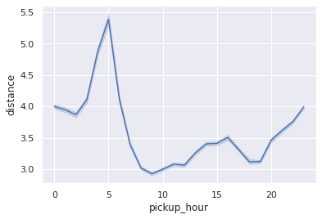
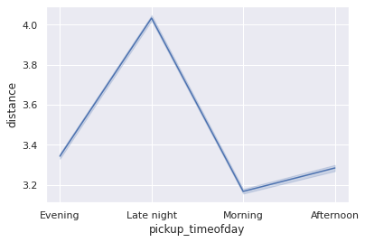
Distance per hour of day
Distance per time of day
Distances are the longest around 5 am
distances being the longest during late night or it maybe called as early morning too. This can probably point to outstation trips where people start early for the day

Slide 20
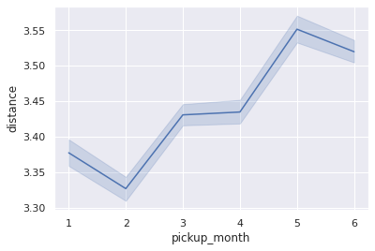
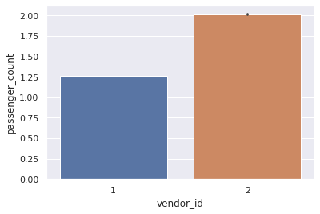
Distance per month
Passenger Count and Vendor id
also saw during trip duration per month, similarly trip distance is the lowest in February and the maximum in June
This shows that vendor 2 generally carries 2 passengers while vendor 1 carries 1 passenger rides

Slide 21
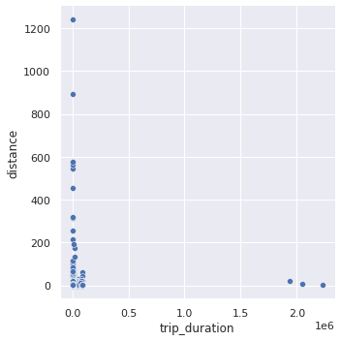
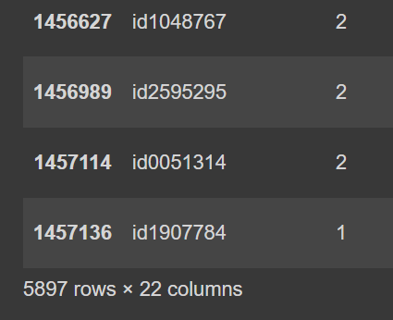
Trip Duration and Distance
5897 with 0 distance
df[df.distance==0]
even though distance is recorded
as 0 but trip duration is definitely
more.
One reason can be that the
dropoff coordinates weren’t recorded.
Another reason one can think is that for short trip durations, maybe the passenger changed their mind and cancelled the ride after some time.
So, we see how Exploratory Data Analysis helps us identify underlying patterns in the data, let us draw out conclusions and this even serves as the basis of feature engineering before we start building our model.
there are trips whose trip duration is as short as 0 seconds and yet cover a large distance. And, as trips with 0 km distance and long trip durations.

Slide 22
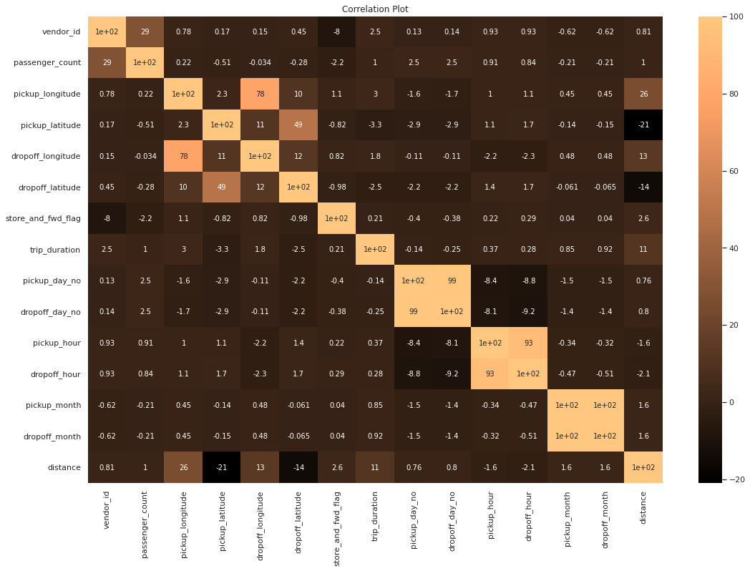
Correlation Heat map

Slide 23
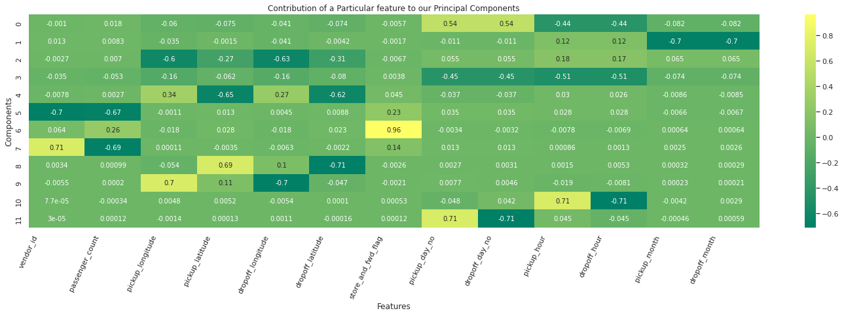
Feature Contribution
The plot above shows the breakdown of which features contributed more or less to each Principal Component.
Our new Principal Features allow you to take in information from all the other original features and make use of it.
We use PCA to reduce the dimensions of our data as much as we can without losing any important information.

Slide 24
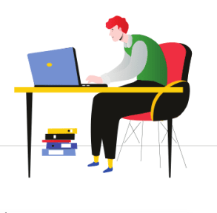

Decomposition of Data:PCA

Slide 25
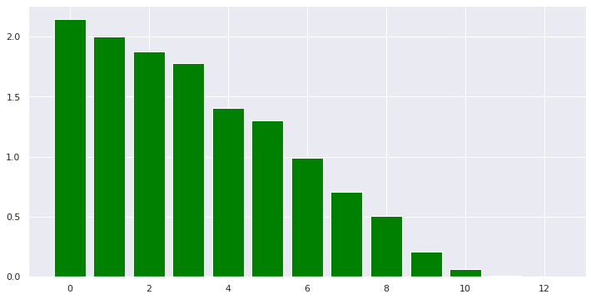
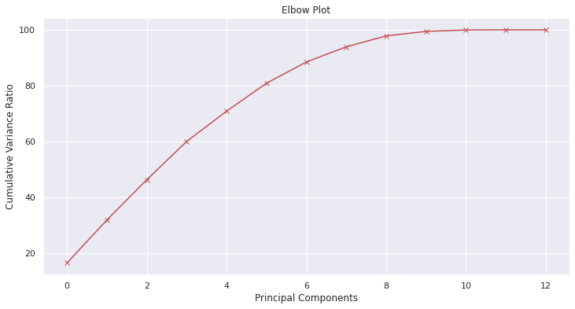
Principal Component Analysis
We apply different transformations to identify the most descriptive components for our data. We see that our PCA model has a smaller variance by the 10th component, compared to the first few components.

Slide 26


Machine Learning Model – Regression
Linear Regression
Decision Tree
Random Forest

Slide 27
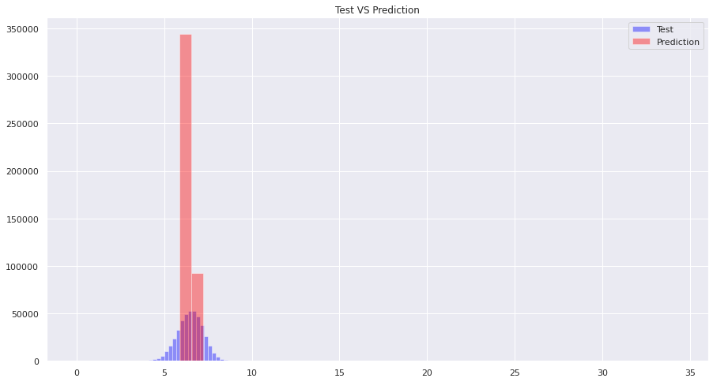
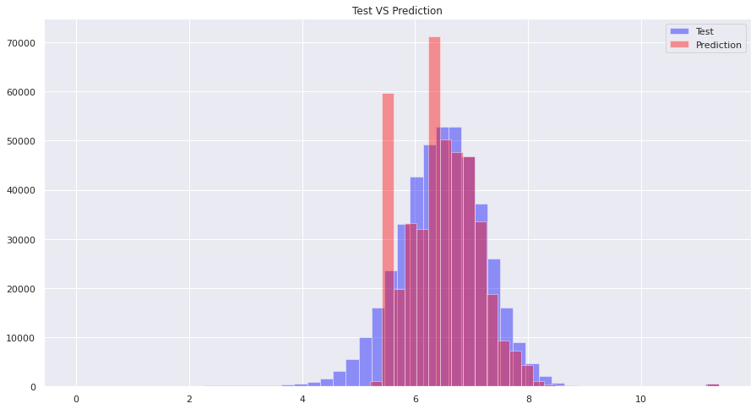
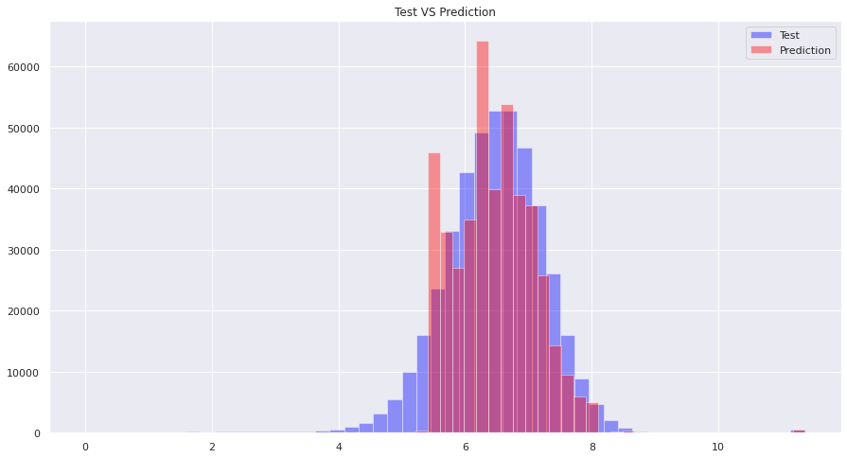
ML Model Prediction with PCA
Linear Regression
Decision Tree
It is clear that decision trees and random forests are performing well as per our visualization.
Random Forest

Slide 28
Model Evaluation Result with PCA
Algorithms | Training Score | Validation Score | Cross Validation Score | R2-Score | RMSE
Linear Regression | 0.0435 | 0.0447 | -0.0502 | -22.33 | --
Decision Tree | 0.6572 | 0.6521 | 0.6494 | 0.4714 | 0.073
Random Forest | 0.6660 | 0.66614 | 0.6609 | 0.4750 | 0.072
R2-score: Usually must be between 0 and 1, with 1 considered as a good fit.
RMSE: Lesser is Better
Our Decision Tree model and Random Forest model do well when evaluated.
As Random Forest is providing reduced RMSE, it's a model to Opted for
The decision tree and random forest models have performed well, with a good fit score of 0.65

Slide 29
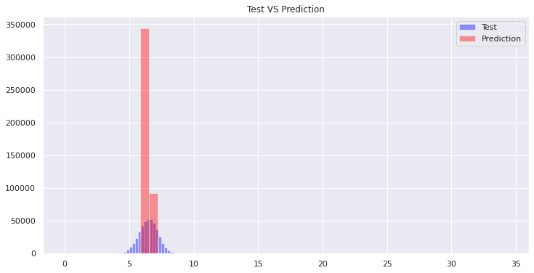
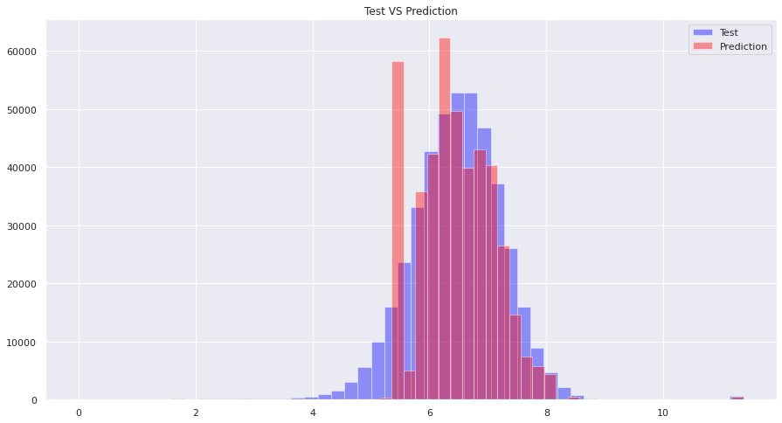
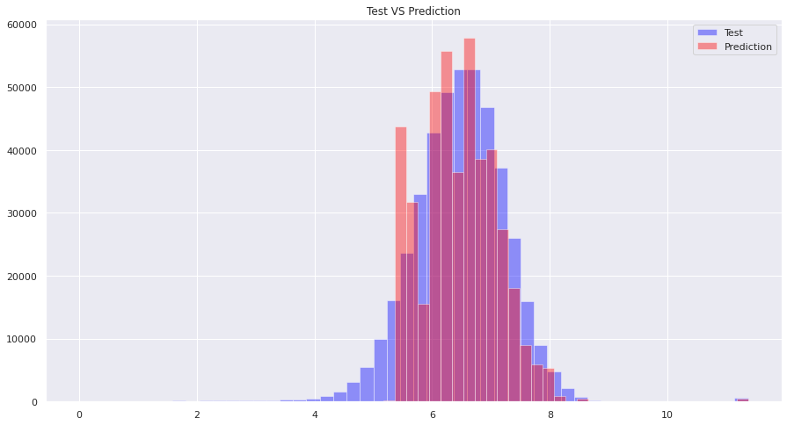
ML Model Prediction without PCA
Another approach we could go with is without PCA, just Standard Scaling Dataset and applying our Algorithms.
The approach can give us better idea of what works better for us.
This approach might take great amount of computational resources and time, it will be good

Slide 30
Model Evaluation Result without PCA
Algorithms | Training Score | Validation Score | Cross Validation Score | R2-Score | RMSE
Linear Regression | 0.0442 | 0.0455 | -0.0493 | -21.95 | --
Decision Tree | 0.4652 | 0.4597 | 0.4573 | -0.1582 | 0.0879
Random Forest | 0.4754 | 0.4704 | 0.4711 | -0.1760 | 0.0871
R2-score: Usually must be between 0 and 1, with 1 considered as a good fit.
RMSE: Lesser is Better
Observations shows us that Linear Regression isn't performing well even.
This model gave us loss of 0.0878, we can say it is good but not the acceptable, knowing the fact that we got RMSE of 0.0879 in previous approach where we applied PCA.
Again the loss value we got here is 0.0871 is good when tried to match with

Slide 31
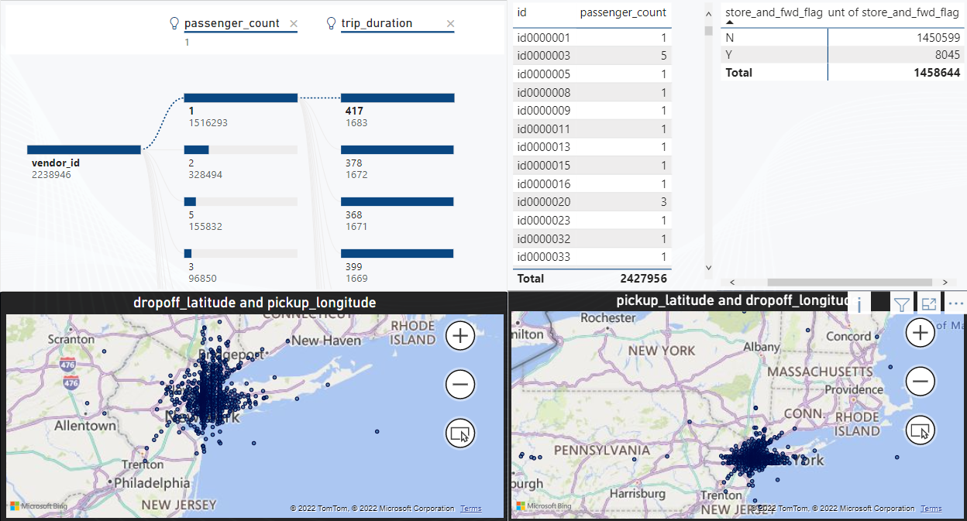
Dekstop view by power bi

Slide 32
Conclusion
I discovered which cab company is almost all frequently utilized by just Folks in NY.
I found out a few trips which had been 528 hours to 972 hours.
Traveler count analysis showed that there have been few flights with zero passengers plus one with several, 8, and disloyal passengers.
The greatest month-to-month trip analysis gives us a great insight into the month– March and April marking the greatest amount of trips, while January marking the most affordable, possibly because of snowfall.
Taxi companies including UBER and OLA are able to analyze the trends of traffic inside the town using similar data. This kind of not only assists with better transport analysis but also assists the authorities in preparing traffic control and monitoring.

Slide 33


